Slide 1

Chapter 6 Arrays

Slide 2
Opening Problem
Read one hundred numbers, compute their average, and find out how many numbers are above the average.

Slide 3

Solution
AnalyzeNumbers
Run with prepared input

Slide 4
Objectives
To describe why arrays are necessary in programming (§6.1).
To declare array reference variables and create arrays (§§6.2.1–6.2.2).
To initialize obtain array size using arrayRefVar.length and know default the values in an array (§6.2.3).
To access array elements using indexed variables (§6.2.4).
To declare, create, and initialize an array using an array initializer (§6.2.5).
To program common array operations (displaying arrays, summing all elements, finding the minimum and maximum elements, random shuffling, and shifting elements) (§6.2.6).
To simplify programming using the for-eachfor-each loops (§6.2.7).
To apply arrays in the application development (LottoNumbers, DeckOfCards) (§§6.3–6.4).
To copy contents from one array to another (§6.5).
To develop and invoke methods with array arguments and return values (§§6.6–6.78).
To define a method with a variable-length argument list (§6.89).
To search elements using the linear (§6.910.1) or binary (§6.910.2) search algorithm.
To sort an array using the selection sort approach (§6.1011.1).
To sort an array using the insertion sort approach (§6.1011.2).
To use the methods in the java.util.Arrays class (§6.1112).

Slide 5
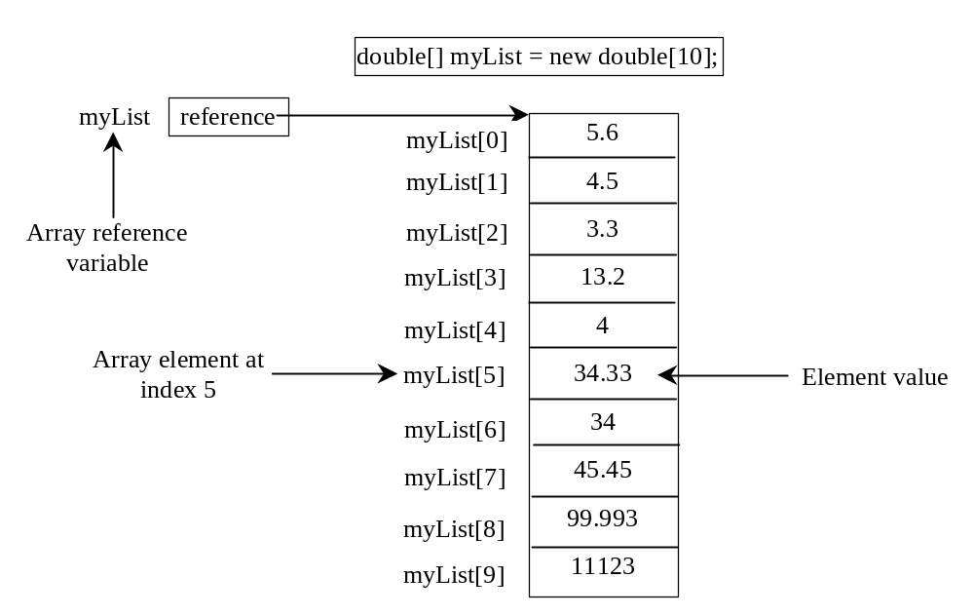
Introducing Arrays
Array is a data structure that represents a collection of the same types of data.

Slide 6
Declaring Array Variables
datatype[] arrayRefVar;
Example:
double[] myList;
datatype arrayRefVar[]; // This style is allowed, but not preferred
Example:
double myList[];

Slide 7
Creating Arrays
arrayRefVar = new datatype[arraySize];
Example:
myList = new double[10];
myList[0] references the first element in the array.
myList[9] references the last element in the array.

Slide 8
Declaring and Creating in One Step
datatype[] arrayRefVar = new
datatype[arraySize];
double[] myList = new double[10];
datatype arrayRefVar[] = new
datatype[arraySize];
double myList[] = new double[10];

Slide 9
The Length of an Array
Once an array is created, its size is fixed. It cannot be changed. You can find its size using
    arrayRefVar.length
For example,
    myList.length returns 10

Slide 10
Default Values
When an array is created, its elements are assigned the default value of
  0 for the numeric primitive data types,
  '\u0000' for char types, and
  false for boolean types.

Slide 11
Indexed Variables
The array elements are accessed through the index. The array indices are 0-based, i.e., it starts from 0 to arrayRefVar.length-1. In the example in Figure 6.1, myList holds ten double values and the indices are from 0 to 9.
Each element in the array is represented using the following syntax, known as an indexed variable:
  arrayRefVar[index];

Slide 12
Using Indexed Variables
After an array is created, an indexed variable can be used in the same way as a regular variable. For example, the following code adds the value in myList[0] and myList[1] to myList[2].
  myList[2] = myList[0] + myList[1];

Slide 13
Array Initializers
Declaring, creating, initializing in one step:
double[] myList = {1.9, 2.9, 3.4, 3.5};
This shorthand syntax must be in one statement.

Slide 14
Declaring, creating, initializing Using the Shorthand Notation
double[] myList = {1.9, 2.9, 3.4, 3.5};
This shorthand notation is equivalent to the following statements:
double[] myList = new double[4];
myList[0] = 1.9;
myList[1] = 2.9;
myList[2] = 3.4;
myList[3] = 3.5;

Slide 15
CAUTION
Using the shorthand notation, you have to declare, create, and initialize the array all in one statement. Splitting it would cause a syntax error. For example, the following is wrong:
  double[] myList;
  myList = {1.9, 2.9, 3.4, 3.5};

Slide 16
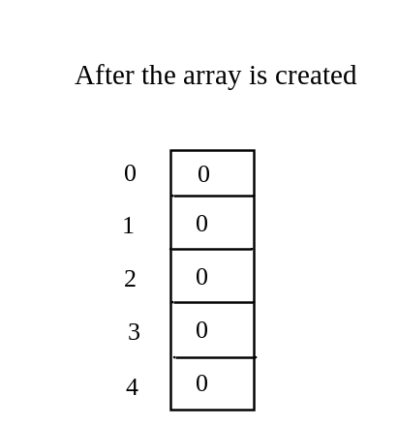
Trace Program with Arrays
animation
Declare array variable values, create an array, and assign its reference to values
public class Test {
public static void main(String[] args) {
int[] values = new int[5];
for (int i = 1; i < 5; i++) {
values[i] = i + values[i-1];
}
values[0] = values[1] + values[4];
}
}

Slide 17
Trace Program with Arrays
animation
i becomes 1
public class Test {
public static void main(String[] args) {
int[] values = new int[5];
for (int i = 1; i < 5; i++) {
values[i] = i + values[i-1];
}
values[0] = values[1] + values[4];
}
}

Slide 18
Trace Program with Arrays
animation
i (=1) is less than 5
public class Test {
public static void main(String[] args) {
int[] values = new int[5];
for (int i = 1; i < 5; i++) {
values[i] = i + values[i-1];
}
values[0] = values[1] + values[4];
}
}

Slide 19
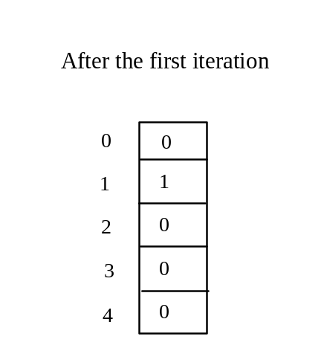
Trace Program with Arrays
animation
After this line is executed, value[1] is 1
public class Test {
public static void main(String[] args) {
int[] values = new int[5];
for (int i = 1; i < 5; i++) {
values[i] = i + values[i-1];
}
values[0] = values[1] + values[4];
}
}

Slide 20
Trace Program with Arrays
animation
After i++, i becomes 2
public class Test {
public static void main(String[] args) {
int[] values = new int[5];
for (int i = 1; i < 5; i++) {
values[i] = i + values[i-1];
}
values[0] = values[1] + values[4];
}
}

Slide 21
Trace Program with Arrays
animation
i (= 2) is less than 5
public class Test {
public static void main(String[] args) {
int[] values = new int[5];
for (int i = 1; i < 5; i++) {
values[i] = i + values[i-1];
}
values[0] = values[1] + values[4];
}
}

Slide 22
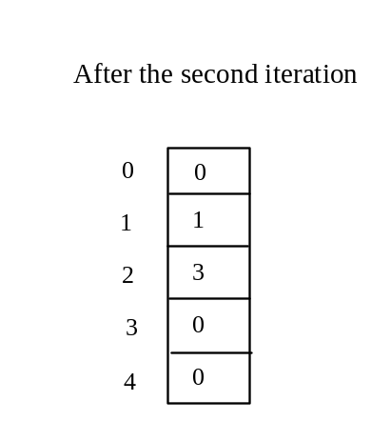
Trace Program with Arrays
animation
After this line is executed,
values[2] is 3 (2 + 1)
public class Test {
public static void main(String[] args) {
int[] values = new int[5];
for (int i = 1; i < 5; i++) {
values[i] = i + values[i-1];
}
values[0] = values[1] + values[4];
}
}

Slide 23
Trace Program with Arrays
animation
After this, i becomes 3.
public class Test {
public static void main(String[] args) {
int[] values = new int[5];
for (int i = 1; i < 5; i++) {
values[i] = i + values[i-1];
}
values[0] = values[1] + values[4];
}
}

Slide 24
Trace Program with Arrays
animation
i (=3) is still less than 5.
public class Test {
public static void main(String[] args) {
int[] values = new int[5];
for (int i = 1; i < 5; i++) {
values[i] = i + values[i-1];
}
values[0] = values[1] + values[4];
}
}

Slide 25
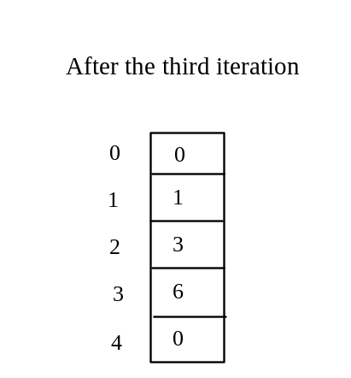
Trace Program with Arrays
animation
After this line, values[3] becomes 6 (3 + 3)
public class Test {
public static void main(String[] args) {
int[] values = new int[5];
for (int i = 1; i < 5; i++) {
values[i] = i + values[i-1];
}
values[0] = values[1] + values[4];
}
}

Slide 26

Trace Program with Arrays
animation
After this, i becomes 4
public class Test {
public static void main(String[] args) {
int[] values = new int[5];
for (int i = 1; i < 5; i++) {
values[i] = i + values[i-1];
}
values[0] = values[1] + values[4];
}
}

Slide 27
Trace Program with Arrays
animation
i (=4) is still less than 5
public class Test {
public static void main(String[] args) {
int[] values = new int[5];
for (int i = 1; i < 5; i++) {
values[i] = i + values[i-1];
}
values[0] = values[1] + values[4];
}
}

Slide 28
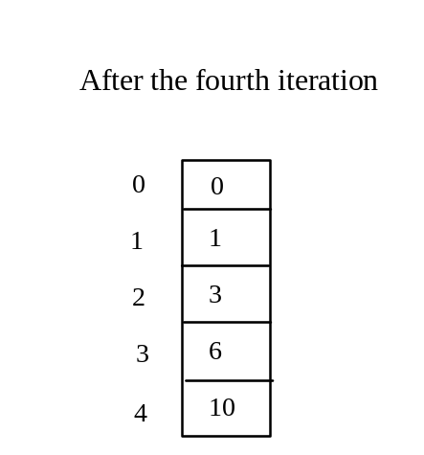
Trace Program with Arrays
animation
After this, values[4] becomes 10 (4 + 6)
public class Test {
public static void main(String[] args) {
int[] values = new int[5];
for (int i = 1; i < 5; i++) {
values[i] = i + values[i-1];
}
values[0] = values[1] + values[4];
}
}

Slide 29
Trace Program with Arrays
animation
After i++, i becomes 5
public class Test {
public static void main(String[] args) {
int[] values = new int[5];
for (int i = 1; i < 5; i++) {
values[i] = i + values[i-1];
}
values[0] = values[1] + values[4];
}
}

Slide 30
Trace Program with Arrays
animation
i ( =5) < 5 is false. Exit the loop
public class Test {
public static void main(String[] args) {
int[] values = new int[5];
for (int i = 1; i < 5; i++) {
values[i] = i + values[i-1];
}
values[0] = values[1] + values[4];
}
}

Slide 31
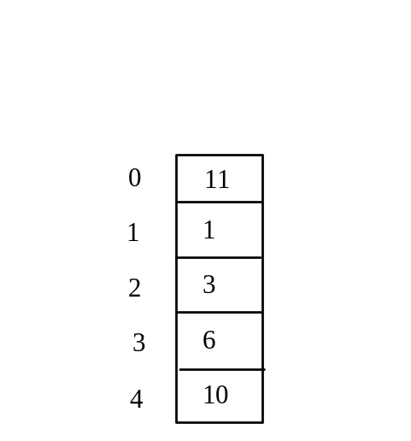
Trace Program with Arrays
animation
After this line, values[0] is 11 (1 + 10)
public class Test {
public static void main(String[] args) {
int[] values = new int[5];
for (int i = 1; i < 5; i++) {
values[i] = i + values[i-1];
}
values[0] = values[1] + values[4];
}
}

Slide 32
Processing Arrays
See the examples in the text.
(Initializing arrays with input values)
(Initializing arrays with random values)
(Printing arrays)
(Summing all elements)
(Finding the largest element)
(Finding the smallest index of the largest element)
(Random shuffling)
(Shifting elements)

Slide 33
Initializing arrays with input values
java.util.Scanner input = new java.util.Scanner(System.in);
System.out.print("Enter " + myList.length + " values: ");
for (int i = 0; i < myList.length; i++)
myList[i] = input.nextDouble();

Slide 34
Initializing arrays with random values
for (int i = 0; i < myList.length; i++) {
myList[i] = Math.random() * 100;
}

Slide 35
Printing arrays
for (int i = 0; i < myList.length; i++) {
System.out.print(myList[i] + " ");
}

Slide 36
Summing all elements
double total = 0;
for (int i = 0; i < myList.length; i++) {
total += myList[i];
}

Slide 37
Finding the largest element
double max = myList[0];
for (int i = 1; i < myList.length; i++) {
if (myList[i] > max) max = myList[i];
}

Slide 38
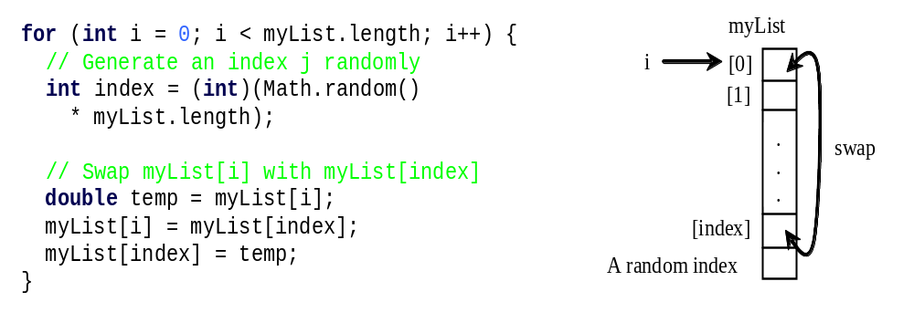
Random shuffling

Slide 39
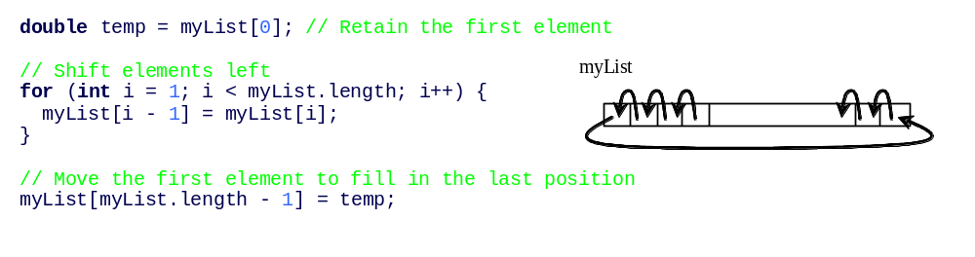
Shifting Elements

Slide 40
Enhanced for Loop (for-each loop)
JDK 1.5 introduced a new for loop that enables you to traverse the complete array sequentially without using an index variable. For example, the following code displays all elements in the array myList:
  for (double value: myList)
  System.out.println(value);
In general, the syntax is
  for (elementType value: arrayRefVar) {
  // Process the value
  }
You still have to use an index variable if you wish to traverse the array in a different order or change the elements in the array.

Slide 41
Problem: Lotto Numbers
Suppose you play the Pick-10 lotto. Each ticket has 10 unique numbers ranging from 1 to 99. You buy a lot of tickets. You like to have your tickets to cover all numbers from 1 to 99. Write a program that reads the ticket numbers from a file and checks whether all numbers are covered. Assume the last number in the file is 0.
Lotto Numbers Sample Data
LottoNumbers
Run

Slide 42
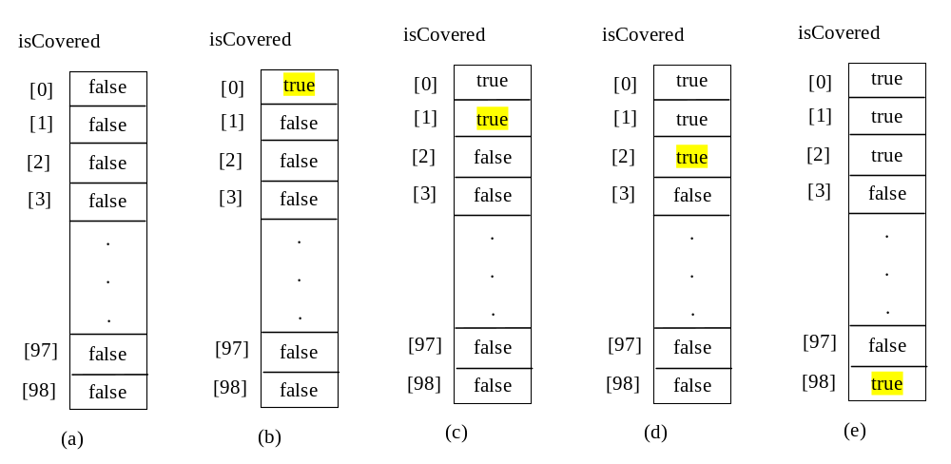
Problem: Lotto Numbers

Slide 43
Problem: Deck of Cards
The problem is to write a program that picks four cards randomly from a deck of 52 cards. All the cards can be represented using an array named deck, filled with initial values 0 to 51, as follows:
  int[] deck = new int[52];
  // Initialize cards
  for (int i = 0; i < deck.length; i++)
  deck[i] = i;
DeckOfCards
Run

Slide 44
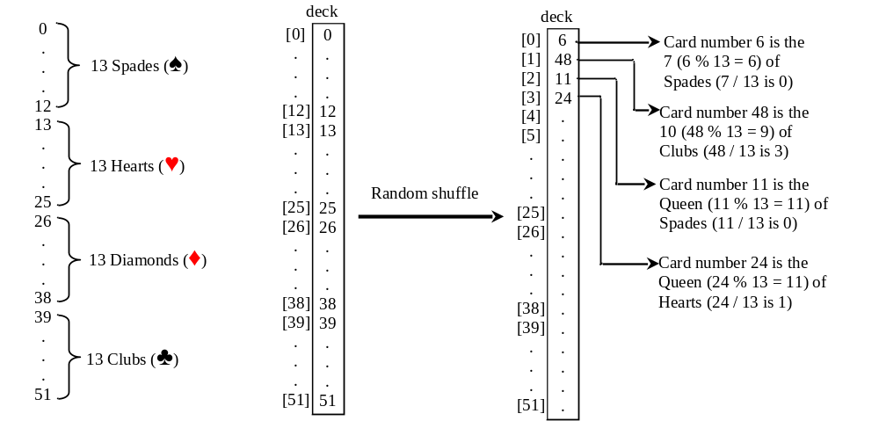
Problem: Deck of Cards, cont.

Slide 45
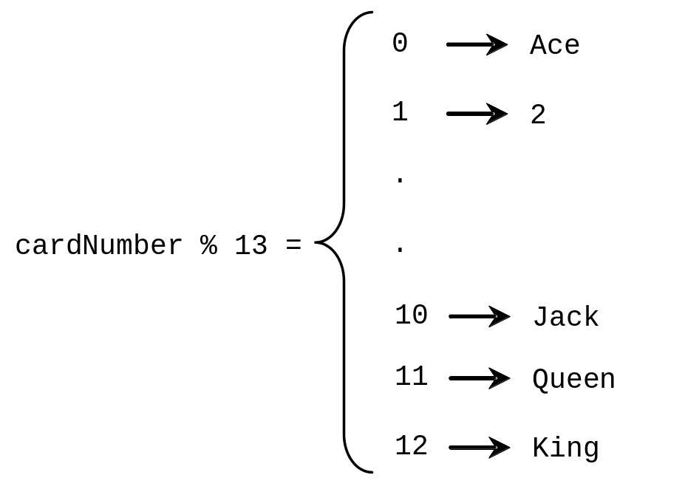
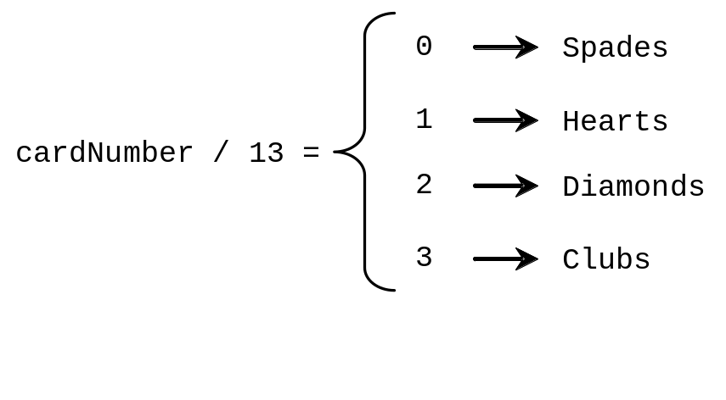
Problem: Deck of Cards, cont.
GUI Demo (picking four cards)
DeckOfCards
Run

Slide 46
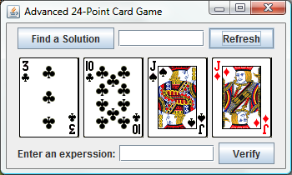
Problem: Deck of Cards
This problem builds a foundation for future more interesting and realistic applications:
See Exercise 22.15.
Run 24 Point Game

Slide 47
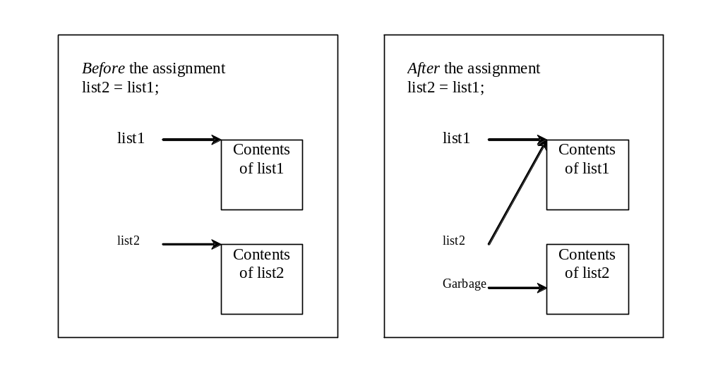
Copying Arrays
Often, in a program, you need to duplicate an array or a part of an array. In such cases you could attempt to use the assignment statement (=), as follows:
list2 = list1;

Slide 48
Copying Arrays
Using a loop:
int[] sourceArray = {2, 3, 1, 5, 10};
int[] targetArray = new int[sourceArray.length];
for (int i = 0; i < sourceArrays.length; i++)
targetArray[i] = sourceArray[i];

Slide 49
The arraycopy Utility
arraycopy(sourceArray, src_pos, targetArray, tar_pos, length);
Example:
System.arraycopy(sourceArray, 0, targetArray, 0, sourceArray.length);

Slide 50
Passing Arrays to Methods
public static void printArray(int[] array) {
for (int i = 0; i < array.length; i++) {
System.out.print(array[i] + " ");
}
}
Invoke the method
int[] list = {3, 1, 2, 6, 4, 2};
printArray(list);
Invoke the method
printArray(new int[]{3, 1, 2, 6, 4, 2});
Anonymous array

Slide 51
Anonymous Array
  The statement
    printArray(new int[]{3, 1, 2, 6, 4, 2});
  creates an array using the following syntax:
    new dataType[]{literal0, literal1, ..., literalk};
  There is no explicit reference variable for the array. Such array is called an anonymous array.

Slide 52
Pass By Value
Java uses pass by value to pass arguments to a method. There are important differences between passing a value of variables of primitive data types and passing arrays.
For a parameter of a primitive type value, the actual value is passed. Changing the value of the local parameter inside the method does not affect the value of the variable outside the method.
For a parameter of an array type, the value of the parameter contains a reference to an array; this reference is passed to the method. Any changes to the array that occur inside the method body will affect the original array that was passed as the argument.

Slide 53
Simple Example
public class Test {
public static void main(String[] args) {
int x = 1; // x represents an int value
int[] y = new int[10]; // y represents an array of int values
m(x, y); // Invoke m with arguments x and y
System.out.println("x is " + x);
System.out.println("y[0] is " + y[0]);
}
public static void m(int number, int[] numbers) {
number = 1001; // Assign a new value to number
numbers[0] = 5555; // Assign a new value to numbers[0]
}
}

Slide 54
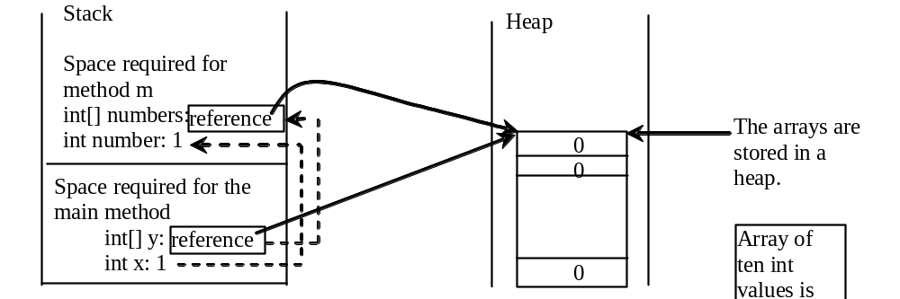
Call Stack
When invoking m(x, y), the values of x and y are passed to number and numbers. Since y contains the reference value to the array, numbers now contains the same reference value to the same array.

Slide 55
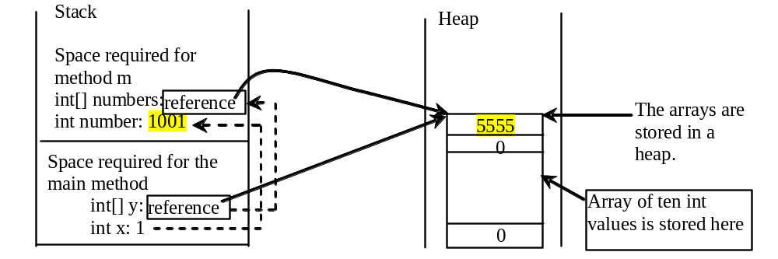
Call Stack
When invoking m(x, y), the values of x and y are passed to number and numbers. Since y contains the reference value to the array, numbers now contains the same reference value to the same array.

Slide 56
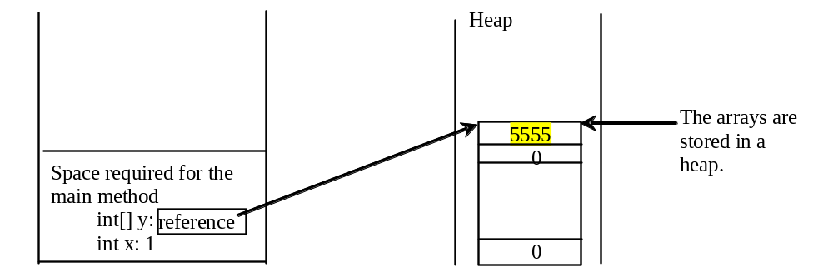
Heap
The JVM stores the array in an area of memory, called heap, which is used for dynamic memory allocation where blocks of memory are allocated and freed in an arbitrary order.

Slide 57
Passing Arrays as Arguments
Objective: Demonstrate differences of passing primitive data type variables and array variables.
TestPassArray
Run

Slide 58
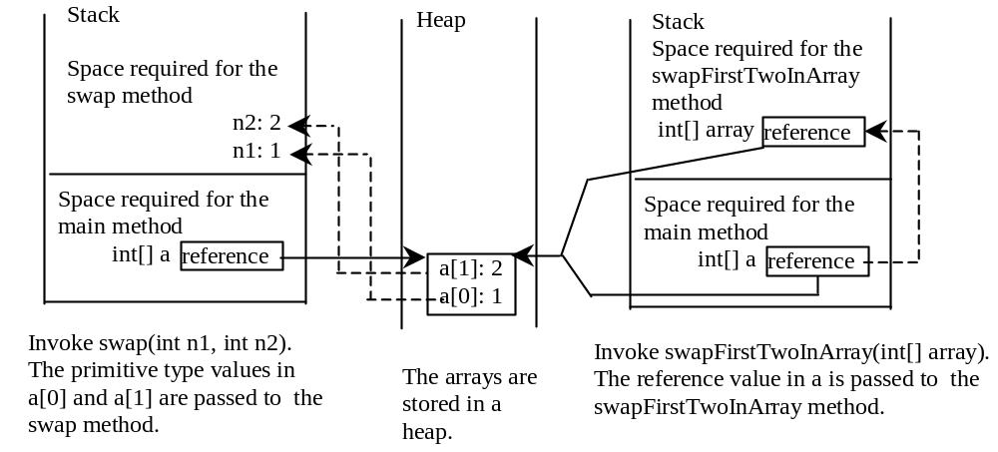
Example, cont.

Slide 59
Returning an Array from a Method
public static int[] reverse(int[] list) {
int[] result = new int[list.length];
for (int i = 0, j = result.length - 1;
i < list.length; i++, j--) {
result[j] = list[i];
}
return result;
}
list
result
int[] list1 = {1, 2, 3, 4, 5, 6};
int[] list2 = reverse(list1);

Slide 60
Trace the reverse Method
animation
int[] list1 = {1, 2, 3, 4, 5, 6};
int[] list2 = reverse(list1);
Declare result and create array
public static int[] reverse(int[] list) {
int[] result = new int[list.length];
for (int i = 0, j = result.length - 1;
i < list.length; i++, j--) {
result[j] = list[i];
}
return result;
}
list
1
2
3
4
5
6
result
0
0
0
0
0
0

Slide 61
Trace the reverse Method, cont.
animation
int[] list1 = {1, 2, 3, 4, 5, 6};
int[] list2 = reverse(list1);
i = 0 and j = 5
public static int[] reverse(int[] list) {
int[] result = new int[list.length];
for (int i = 0, j = result.length - 1;
i < list.length; i++, j--) {
result[j] = list[i];
}
return result;
}
list
1
2
3
4
5
6
result
0
0
0
0
0
0

Slide 62
Trace the reverse Method, cont.
animation
int[] list1 = {1, 2, 3, 4, 5, 6};
int[] list2 = reverse(list1);
i (= 0) is less than 6
public static int[] reverse(int[] list) {
int[] result = new int[list.length];
for (int i = 0, j = result.length - 1;
i < list.length; i++, j--) {
result[j] = list[i];
}
return result;
}
list
1
2
3
4
5
6
result
0
0
0
0
0
0

Slide 63
Trace the reverse Method, cont.
animation
int[] list1 = {1, 2, 3, 4, 5, 6};
int[] list2 = reverse(list1);
i = 0 and j = 5
Assign list[0] to result[5]
public static int[] reverse(int[] list) {
int[] result = new int[list.length];
for (int i = 0, j = result.length - 1;
i < list.length; i++, j--) {
result[j] = list[i];
}
return result;
}
list
1
2
3
4
5
6
result
0
0
0
0
0
1

Slide 64
Trace the reverse Method, cont.
animation
int[] list1 = {1, 2, 3, 4, 5, 6};
int[] list2 = reverse(list1);
After this, i becomes 1 and j becomes 4
public static int[] reverse(int[] list) {
int[] result = new int[list.length];
for (int i = 0, j = result.length - 1;
i < list.length; i++, j--) {
result[j] = list[i];
}
return result;
}
list
1
2
3
4
5
6
result
0
0
0
0
0
1

Slide 65
Trace the reverse Method, cont.
animation
int[] list1 = {1, 2, 3, 4, 5, 6};
int[] list2 = reverse(list1);
i (=1) is less than 6
public static int[] reverse(int[] list) {
int[] result = new int[list.length];
for (int i = 0, j = result.length - 1;
i < list.length; i++, j--) {
result[j] = list[i];
}
return result;
}
list
1
2
3
4
5
6
result
0
0
0
0
0
1

Slide 66
Trace the reverse Method, cont.
animation
int[] list1 = {1, 2, 3, 4, 5, 6};
int[] list2 = reverse(list1);
i = 1 and j = 4
Assign list[1] to result[4]
public static int[] reverse(int[] list) {
int[] result = new int[list.length];
for (int i = 0, j = result.length - 1;
i < list.length; i++, j--) {
result[j] = list[i];
}
return result;
}
list
1
2
3
4
5
6
result
0
0
0
0
2
1

Slide 67
Trace the reverse Method, cont.
animation
int[] list1 = {1, 2, 3, 4, 5, 6};
int[] list2 = reverse(list1);
After this, i becomes 2 and j becomes 3
public static int[] reverse(int[] list) {
int[] result = new int[list.length];
for (int i = 0, j = result.length - 1;
i < list.length; i++, j--) {
result[j] = list[i];
}
return result;
}
list
1
2
3
4
5
6
result
0
0
0
0
2
1

Slide 68
Trace the reverse Method, cont.
animation
int[] list1 = {1, 2, 3, 4, 5, 6};
int[] list2 = reverse(list1);
i (=2) is still less than 6
public static int[] reverse(int[] list) {
int[] result = new int[list.length];
for (int i = 0, j = result.length - 1;
i < list.length; i++, j--) {
result[j] = list[i];
}
return result;
}
list
1
2
3
4
5
6
result
0
0
0
0
2
1

Slide 69
Trace the reverse Method, cont.
animation
int[] list1 = {1, 2, 3, 4, 5, 6};
int[] list2 = reverse(list1);
i = 2 and j = 3
Assign list[i] to result[j]
public static int[] reverse(int[] list) {
int[] result = new int[list.length];
for (int i = 0, j = result.length - 1;
i < list.length; i++, j--) {
result[j] = list[i];
}
return result;
}
list
1
2
3
4
5
6
result
0
0
0
3
2
1

Slide 70
Trace the reverse Method, cont.
animation
int[] list1 = {1, 2, 3, 4, 5, 6};
int[] list2 = reverse(list1);
After this, i becomes 3 and j becomes 2
public static int[] reverse(int[] list) {
int[] result = new int[list.length];
for (int i = 0, j = result.length - 1;
i < list.length; i++, j--) {
result[j] = list[i];
}
return result;
}
list
1
2
3
4
5
6
result
0
0
0
3
2
1

Slide 71
Trace the reverse Method, cont.
animation
int[] list1 = {1, 2, 3, 4, 5, 6};
int[] list2 = reverse(list1);
i (=3) is still less than 6
public static int[] reverse(int[] list) {
int[] result = new int[list.length];
for (int i = 0, j = result.length - 1;
i < list.length; i++, j--) {
result[j] = list[i];
}
return result;
}
list
1
2
3
4
5
6
result
0
0
0
3
2
1

Slide 72
Trace the reverse Method, cont.
animation
int[] list1 = {1, 2, 3, 4, 5, 6};
int[] list2 = reverse(list1);
i = 3 and j = 2
Assign list[i] to result[j]
public static int[] reverse(int[] list) {
int[] result = new int[list.length];
for (int i = 0, j = result.length - 1;
i < list.length; i++, j--) {
result[j] = list[i];
}
return result;
}
list
1
2
3
4
5
6
result
0
0
4
3
2
1

Slide 73
Trace the reverse Method, cont.
animation
int[] list1 = {1, 2, 3, 4, 5, 6};
int[] list2 = reverse(list1);
After this, i becomes 4 and j becomes 1
public static int[] reverse(int[] list) {
int[] result = new int[list.length];
for (int i = 0, j = result.length - 1;
i < list.length; i++, j--) {
result[j] = list[i];
}
return result;
}
list
1
2
3
4
5
6
result
0
0
4
3
2
1

Slide 74
Trace the reverse Method, cont.
animation
int[] list1 = {1, 2, 3, 4, 5, 6};
int[] list2 = reverse(list1);
i (=4) is still less than 6
public static int[] reverse(int[] list) {
int[] result = new int[list.length];
for (int i = 0, j = result.length - 1;
i < list.length; i++, j--) {
result[j] = list[i];
}
return result;
}
list
1
2
3
4
5
6
result
0
0
4
3
2
1

Slide 75
Trace the reverse Method, cont.
animation
int[] list1 = {1, 2, 3, 4, 5, 6};
int[] list2 = reverse(list1);
i = 4 and j = 1
Assign list[i] to result[j]
public static int[] reverse(int[] list) {
int[] result = new int[list.length];
for (int i = 0, j = result.length - 1;
i < list.length; i++, j--) {
result[j] = list[i];
}
return result;
}
list
1
2
3
4
5
6
result
0
5
4
3
2
1

Slide 76
Trace the reverse Method, cont.
animation
int[] list1 = {1, 2, 3, 4, 5, 6};
int[] list2 = reverse(list1);
After this, i becomes 5 and j becomes 0
public static int[] reverse(int[] list) {
int[] result = new int[list.length];
for (int i = 0, j = result.length - 1;
i < list.length; i++, j--) {
result[j] = list[i];
}
return result;
}
list
1
2
3
4
5
6
result
0
5
4
3
2
1

Slide 77
Trace the reverse Method, cont.
animation
int[] list1 = {1, 2, 3, 4, 5, 6};
int[] list2 = reverse(list1);
i (=5) is still less than 6
public static int[] reverse(int[] list) {
int[] result = new int[list.length];
for (int i = 0, j = result.length - 1;
i < list.length; i++, j--) {
result[j] = list[i];
}
return result;
}
list
1
2
3
4
5
6
result
0
5
4
3
2
1

Slide 78
Trace the reverse Method, cont.
animation
int[] list1 = {1, 2, 3, 4, 5, 6};
int[] list2 = reverse(list1);
i = 5 and j = 0
Assign list[i] to result[j]
public static int[] reverse(int[] list) {
int[] result = new int[list.length];
for (int i = 0, j = result.length - 1;
i < list.length; i++, j--) {
result[j] = list[i];
}
return result;
}
list
1
2
3
4
5
6
result
6
5
4
3
2
1

Slide 79
Trace the reverse Method, cont.
animation
int[] list1 = {1, 2, 3, 4, 5, 6};
int[] list2 = reverse(list1);
After this, i becomes 6 and j becomes -1
public static int[] reverse(int[] list) {
int[] result = new int[list.length];
for (int i = 0, j = result.length - 1;
i < list.length; i++, j--) {
result[j] = list[i];
}
return result;
}
list
1
2
3
4
5
6
result
6
5
4
3
2
1

Slide 80
Trace the reverse Method, cont.
animation
int[] list1 = {1, 2, 3, 4, 5, 6};
int[] list2 = reverse(list1);
i (=6) < 6 is false. So exit the loop.
public static int[] reverse(int[] list) {
int[] result = new int[list.length];
for (int i = 0, j = result.length - 1;
i < list.length; i++, j--) {
result[j] = list[i];
}
return result;
}
list
1
2
3
4
5
6
result
6
5
4
3
2
1

Slide 81
Trace the reverse Method, cont.
animation
int[] list1 = {1, 2, 3, 4, 5, 6};
int[] list2 = reverse(list1);
Return result
public static int[] reverse(int[] list) {
int[] result = new int[list.length];
for (int i = 0, j = result.length - 1;
i < list.length; i++, j--) {
result[j] = list[i];
}
return result;
}
list
1
2
3
4
5
6
list2
result
6
5
4
3
2
1

Slide 82
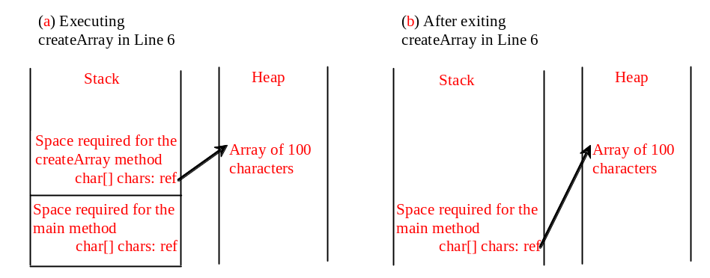
Problem: Counting Occurrence of Each Letter
Generate 100 lowercase letters randomly and assign to an array of characters.
Count the occurrence of each letter in the array.
CountLettersInArray
Run

Slide 83
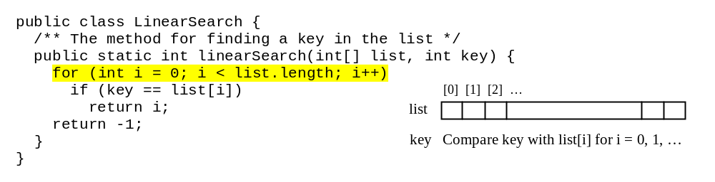
Searching Arrays
Searching is the process of looking for a specific element in an array; for example, discovering whether a certain score is included in a list of scores. Searching is a common task in computer programming. There are many algorithms and data structures devoted to searching. In this section, two commonly used approaches are discussed, linear search and binary search.

Slide 84
Linear Search
The linear search approach compares the key element, key, sequentially with each element in the array list. The method continues to do so until the key matches an element in the list or the list is exhausted without a match being found. If a match is made, the linear search returns the index of the element in the array that matches the key. If no match is found, the search returns -1.

Slide 85
Linear Search Animation
animation
Key
List
3
6 | 4 | 1 | 9 | 7 | 3 | 2 | 8
3
6 | 4 | 1 | 9 | 7 | 3 | 2 | 8
3
6 | 4 | 1 | 9 | 7 | 3 | 2 | 8
3
6 | 4 | 1 | 9 | 7 | 3 | 2 | 8
3
6 | 4 | 1 | 9 | 7 | 3 | 2 | 8
3
6 | 4 | 1 | 9 | 7 | 3 | 2 | 8

Slide 86
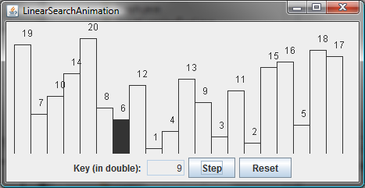
Linear Search Animation
animation
http://www.cs.armstrong.edu/liang/animation/LinearSearchAnimation.html

Slide 87
From Idea to Solution
/** The method for finding a key in the list */
public static int linearSearch(int[] list, int key) {
for (int i = 0; i < list.length; i++)
if (key == list[i])
return i;
return -1;
}
Trace the method
int[] list = {1, 4, 4, 2, 5, -3, 6, 2};
int i = linearSearch(list, 4); // returns 1
int j = linearSearch(list, -4); // returns -1
int k = linearSearch(list, -3); // returns 5

Slide 88
Binary Search
For binary search to work, the elements in the array must already be ordered. Without loss of generality, assume that the array is in ascending order.
  e.g., 2 4 7 10 11 45 50 59 60 66 69 70 79
The binary search first compares the key with the element in the middle of the array.

Slide 89
Binary Search, cont.
Consider the following three cases:
If the key is less than the middle element, you only need to search the key in the first half of the array.
If the key is equal to the middle element, the search ends with a match.
If the key is greater than the middle element, you only need to search the key in the second half of the array.

Slide 90
Binary Search
animation
Key
List
8
1 | 2 | 3 | 4 | 6 | 7 | 8 | 9
8
1 | 2 | 3 | 4 | 6 | 7 | 8 | 9
8
1 | 2 | 3 | 4 | 6 | 7 | 8 | 9

Slide 91
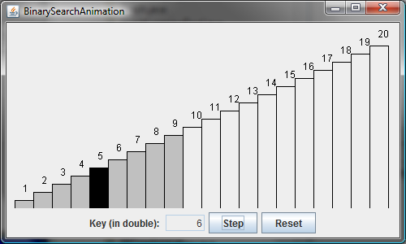
Binary Search Animation
animation
http://www.cs.armstrong.edu/liang/animation/BinarySearchAnimation.html

Slide 92
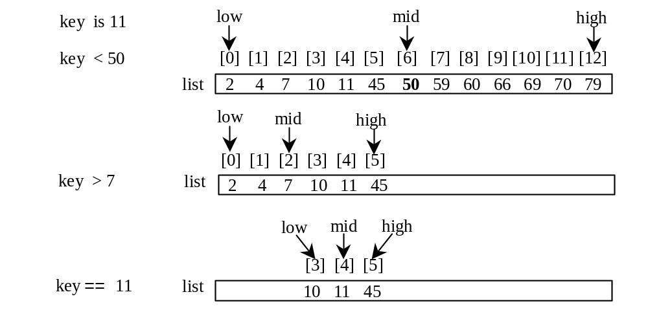
Binary Search, cont.

Slide 93
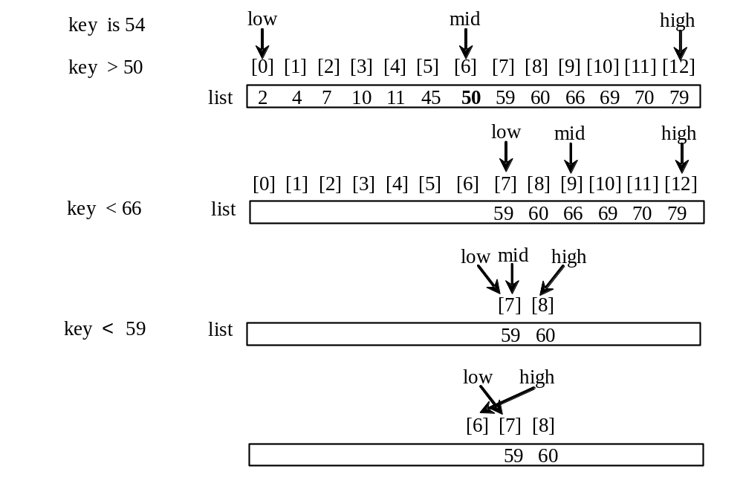
Binary Search, cont.

Slide 94
Binary Search, cont.
The binarySearch method returns the index of the element in the list that matches the search key if it is contained in the list. Otherwise, it returns
-insertion point - 1.
The insertion point is the point at which the key would be inserted into the list.

Slide 95
From Idea to Soluton
/** Use binary search to find the key in the list */
public static int binarySearch(int[] list, int key) {
int low = 0;
int high = list.length - 1;
while (high >= low) {
int mid = (low + high) / 2;
if (key < list[mid])
high = mid - 1;
else if (key == list[mid])
return mid;
else
low = mid + 1;
}
return -1 - low;
}

Slide 96
The Arrays.binarySearch Method
Since binary search is frequently used in programming, Java provides several overloaded binarySearch methods for searching a key in an array of int, double, char, short, long, and float in the java.util.Arrays class. For example, the following code searches the keys in an array of numbers and an array of characters.
  int[] list = {2, 4, 7, 10, 11, 45, 50, 59, 60, 66, 69, 70, 79};
  System.out.println("Index is " +
  java.util.Arrays.binarySearch(list, 11));
  char[] chars = {'a', 'c', 'g', 'x', 'y', 'z'};
  System.out.println("Index is " +
  java.util.Arrays.binarySearch(chars, 't'));
For the binarySearch method to work, the array must be pre-sorted in increasing order.
Return is 4
Return is –4 (insertion point is 3, so return is -3-1)

Slide 97
Sorting Arrays
Sorting, like searching, is also a common task in computer programming. Many different algorithms have been developed for sorting. This section introduces two simple, intuitive sorting algorithms: selection sort and insertion sort.

Slide 98
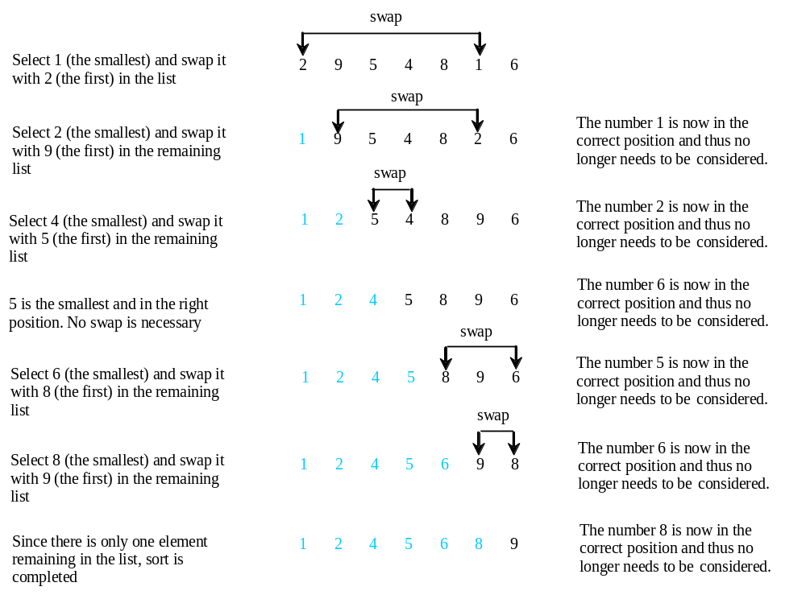
Selection Sort
Selection sort finds the smallest number in the list and places it first. It then finds the smallest number remaining and places it second, and so on until the list contains only a single number.

Slide 99
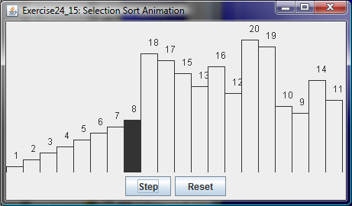
Selection Sort Animation
animation
http://www.cs.armstrong.edu/liang/animation/SelectionSortAnimation.html

Slide 100
From Idea to Solution
for (int i = 0; i < list.length; i++)
{
select the smallest element in list[i..listSize-1];
swap the smallest with list[i], if necessary;
// list[i] is in its correct position.
// The next iteration apply on list[i..listSize-1]
}
list[0] list[1] list[2] list[3] ... list[10]
list[0] list[1] list[2] list[3] ... list[10]
list[0] list[1] list[2] list[3] ... list[10]
list[0] list[1] list[2] list[3] ... list[10]
list[0] list[1] list[2] list[3] ... list[10]
...
list[0] list[1] list[2] list[3] ... list[10]

Slide 101
Expand
for (int i = 0; i < listSize; i++)
{
select the smallest element in list[i..listSize-1];
swap the smallest with list[i], if necessary;
// list[i] is in its correct position.
// The next iteration apply on list[i..listSize-1]
}
double currentMin = list[i];
int currentMinIndex = i;
for (int j = i+1; j < list.length; j++) {
if (currentMin > list[j]) {
currentMin = list[j];
currentMinIndex = j;
}
}

Slide 102
Expand
for (int i = 0; i < listSize; i++)
{
select the smallest element in list[i..listSize-1];
swap the smallest with list[i], if necessary;
// list[i] is in its correct position.
// The next iteration apply on list[i..listSize-1]
}
double currentMin = list[i];
int currentMinIndex = i;
for (int j = i; j < list.length; j++) {
if (currentMin > list[j]) {
currentMin = list[j];
currentMinIndex = j;
}
}

Slide 103
Expand
for (int i = 0; i < listSize; i++)
{
select the smallest element in list[i..listSize-1];
swap the smallest with list[i], if necessary;
// list[i] is in its correct position.
// The next iteration apply on list[i..listSize-1]
}
if (currentMinIndex != i) {
list[currentMinIndex] = list[i];
list[i] = currentMin;
}

Slide 104
Wrap it in a Method
/** The method for sorting the numbers */
public static void selectionSort(double[] list) {
for (int i = 0; i < list.length; i++) {
// Find the minimum in the list[i..list.length-1]
double currentMin = list[i];
int currentMinIndex = i;
for (int j = i + 1; j < list.length; j++) {
if (currentMin > list[j]) {
currentMin = list[j];
currentMinIndex = j;
}
}
// Swap list[i] with list[currentMinIndex] if necessary;
if (currentMinIndex != i) {
list[currentMinIndex] = list[i];
list[i] = currentMin;
}
}
}
Invoke it
selectionSort(yourList)

Slide 105
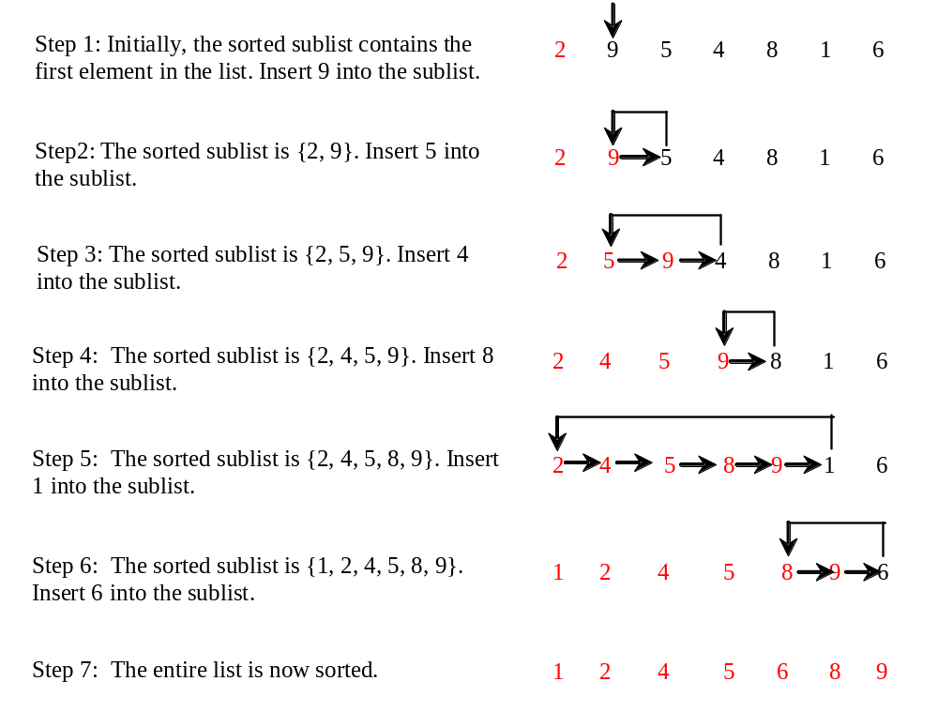
Insertion Sort
int[] myList = {2, 9, 5, 4, 8, 1, 6}; // Unsorted
The insertion sort algorithm sorts a list of values by repeatedly inserting an unsorted element into a sorted sublist until the whole list is sorted.

Slide 106
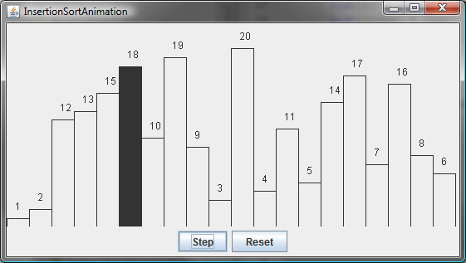
Insertion Sort Animation
animation
http://www.cs.armstrong.edu/liang/animation/InsertionSortAnimation.html

Slide 107
Insertion Sort
animation
int[] myList = {2, 9, 5, 4, 8, 1, 6}; // Unsorted
2 | 9 | 5 | 4 | 8 | 1 | 6
2 | 9 | 5 | 4 | 8 | 1 | 6
2 | 5 | 9 | 4 | 8 | 1 | 6
2 | 4 | 5 | 9 | 8 | 1 | 6
2 | 4 | 5 | 8 | 9 | 1 | 6
1 | 2 | 4 | 5 | 8 | 9 | 6
1 | 2 | 4 | 5 | 6 | 8 | 9

Slide 108
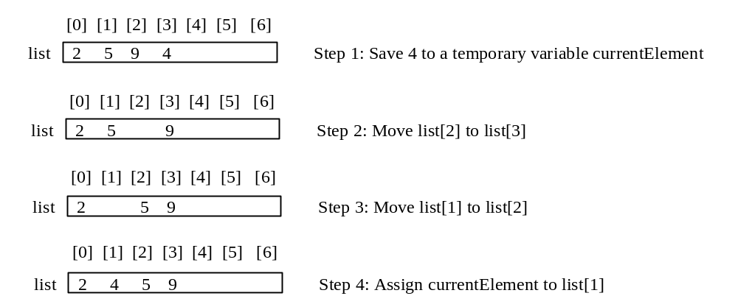
How to Insert?
The insertion sort algorithm sorts a list of values by repeatedly inserting an unsorted element into a sorted sublist until the whole list is sorted.

Slide 109
From Idea to Solution
for (int i = 1; i < list.length; i++) {
insert list[i] into a sorted sublist list[0..i-1] so that
list[0..i] is sorted
}
list[0]
list[0] list[1]
list[0] list[1] list[2]
list[0] list[1] list[2] list[3]
list[0] list[1] list[2] list[3] ...

Slide 110
From Idea to Solution
for (int i = 1; i < list.length; i++) {
insert list[i] into a sorted sublist list[0..i-1] so that
list[0..i] is sorted
}
Expand
double currentElement = list[i];
int k;
for (k = i - 1; k >= 0 && list[k] > currentElement; k--) {
list[k + 1] = list[k];
}
// Insert the current element into list[k + 1]
list[k + 1] = currentElement;
InsertSort

Slide 111
The Arrays.sort Method
Since sorting is frequently used in programming, Java provides several overloaded sort methods for sorting an array of int, double, char, short, long, and float in the java.util.Arrays class. For example, the following code sorts an array of numbers and an array of characters.
  double[] numbers = {6.0, 4.4, 1.9, 2.9, 3.4, 3.5};
  java.util.Arrays.sort(numbers);
  char[] chars = {'a', 'A', '4', 'F', 'D', 'P'};
  java.util.Arrays.sort(chars);

